Slide 1
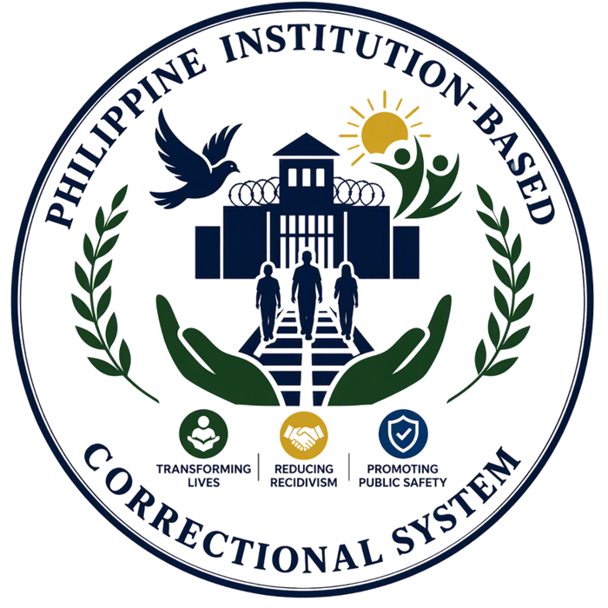
University of Cebu Lapu-Lapu and Mandaue
Graduate School
Master of Science in Criminal Justice
with Specialization in Criminology
A Topic Report:
THE PHILIPPINE CORRECTIONAL SYSTEM: INSTITUTION-BASED CORRECTIONS
MSCJ 109 - Modern Penology
Presented to:
Paul Pioquinto
Presented by:
Sacurom, Lovely Mae E.

Slide 2
MODERN PENOLOGY
01
Learning Objectives
06
Opportunities
02
Introduction
07
Threats
Today’s Agenda
03
Reflection Presentation
08
Conclusion
04
Strength
09
Recommendations
05
Weaknesses
10
References
MSCJ 109 · Modern Penology
2

Slide 3



MODERN PENOLOGY
Learning Objectives
COGNITIVE
AFFECTIVE
PSYCHOMOTOR
Focuses on changing criminal thinking.
Promotes positive behavior and values.
Improves decision-making skills.
Encourages personal responsibility.
Supports rehabilitation and reintegration.
Develops positive values and attitudes
Promotes respect for laws and society
Builds self-discipline and responsibility
Encourages empathy and accountability
Supports personal and moral growth
Develops vocational and technical skills
Enhances work habits and discipline
Provides livelihood training
Promotes productive use of time
Prepares PDLs for employment after release
MSCJ 109 · Modern Penology
3

Slide 4
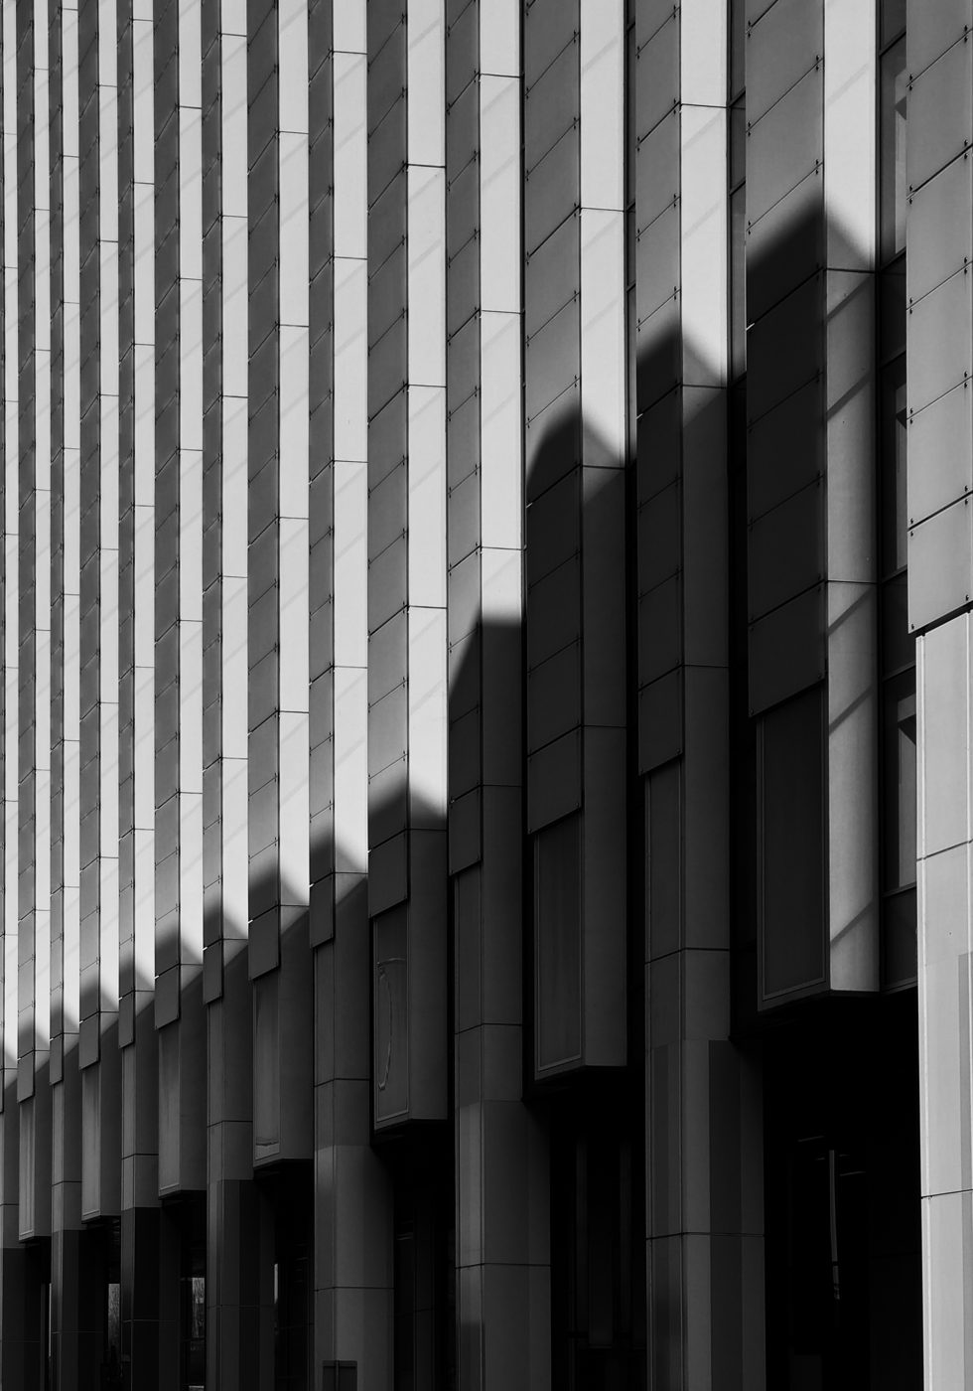
1
Institution-Based Corrections is a component of the Philippine Correctional System.
2
It involves the custody, supervision, and rehabilitation of PDLs in correctional facilities.
3
Managed primarily by the Bureau of Corrections (BuCor).
4
Focuses on rehabilitation, reintegration, and public safety.
Introduction
Aims to transform offenders into productive members of society.
5
MSCJ 109 · Modern Penology
4

Slide 5
MODERN PENOLOGY
Reflection Presentation
S
W
STRENGTH
WEAKNESSES
Effective offender custody and rehabilitation programs
Overcrowding and limited resources
O
T
OPPORTUNITIES
THREATS
Modernization, partnerships, and expanded rehabilitation services.
Rising inmate population, security concerns, and social stigma.
MSCJ 109 · Modern Penology
5

Slide 6



MODERN PENOLOGY
Strength
01
02
03
Security and Public Protection
Rehabilitation and Behavior Change
Reintegration and Personal Development
MSCJ 109 · Modern Penology
6

Slide 7
STRENGTH
01
Institution-based corrections keep convicted offenders in secure facilities, preventing them from committing further crimes in the community.
01
Security and Public Protection
02
Correctional institutions maintain order and security through established rules, supervision, and monitoring.
03
It helps protect citizens while offenders serve their sentence.
MSCJ 109 · Modern Penology
7

Slide 8
STRENGTH
01
Inmates are given access to educational programs, literacy classes, vocational training, and spiritual activities
02
Rehabilitation and Behavior Change
02
These programs help develop positive values, discipline, and work skills.
03
Rehabilitation reduces the likelihood of offenders returning to criminal activities after release.
MSCJ 109 · Modern Penology
8

Slide 9
STRENGTH
01
Correctional facilities provide livelihood and skills training that can help inmates find employment after release.
03
Reintegration and Personal Development
02
Programs encourage personal growth, responsibility, and social adjustment.
03
Reintegration efforts contribute to reducing recidivism and promoting community stability.
MSCJ 109 · Modern Penology
9

Slide 10




MODERN PENOLOGY
Weaknesses
01
02
03
Overcrowding in Correctional Facilities
Limited Resources and Facilities
Challenges in Rehabilitation Programs
MSCJ 109 · Modern Penology
10

Slide 11
WEAKNESSES · 1
Overcrowding in Correctional Facilities
01
02
Many correctional facilities house more inmates than their intended capacity.
Overcrowding results in limited space, poor living conditions, and strained resources.
03
04
It becomes difficult to effectively supervise and manage inmates.
Rehabilitation programs may not reach all inmates due to the large population.
MSCJ 109 · Modern Penology
11

Slide 12
WEAKNESSES · 2
Limited Resources and Facilities
01
02
Some correctional facilities face shortages in personnel, equipment, and rehabilitation resources.
Aging buildings require maintenance and modernization.
03
04
Limited budgets can affect healthcare, education, and vocational training programs.
Staff may experience increased workload due to the high inmate population.
MSCJ 109 · Modern Penology
12

Slide 13
WEAKNESSES · 2
Five-Year Improvement in Staffing
Year | Officer-to-PDL Ratio
2021 | 1:40
2022 | 1:29
2023 | 1:26
2024 | 1:24
2025 | 1:20
MSCJ 109 · Modern Penology
13

Slide 14
WEAKNESSES · 3
Challenges in Rehabilitation Programs
01
02
Not all inmates can participate in educational and vocational programs.
Rehabilitation activities may vary depending on facility capacity and resources.
03
04
Some inmates may leave prison without sufficient preparation for reintegration.
This can contribute to repeat offenses or difficulties in adapting to society.
MSCJ 109 · Modern Penology
14

Slide 15



MODERN PENOLOGY
Opportunities
01
02
03
MODERNIZATION OF CORRECTIONAL FACILITIES
EXPANSION OF REHABILITATION PROGRAMS
PARTNERSHIPS AND COMMUNITY SUPPORT
MSCJ 109 · Modern Penology
15

Slide 16
OPPORTUNITIES · 1
Modernization of Correctional Facilities
01
02
Modernize prison facilities to improve living conditions and security.
Adopt digital record management systems for efficient inmate monitoring.
03
04
Improve healthcare, sanitation, and housing within correctional institutions.
Enhance safety for both inmates and correctional personnel.
MSCJ 109 · Modern Penology
16

Slide 17
OPPORTUNITIES · 2
Expansion of Rehabilitation Programs
01
02
Expand educational and vocational training programs.
Offer more livelihood opportunities and skills certification.
03
04
Increase access to counseling, mental health, and behavioral interventions.
Equip inmates with skills needed for employment after release.
MSCJ 109 · Modern Penology
17

Slide 18
OPPORTUNITIES · 3
Partnerships and Community Support
01
02
Partner with NGOs, educational institutions, and private organizations.
Develop employment opportunities for former inmates.
03
04
Encourage community-based reintegration programs.
Promote public awareness to reduce stigma against ex-offenders.
MSCJ 109 · Modern Penology
18

Slide 19



MODERN PENOLOGY
Threats
01
02
03
Increasing Inmate Population
Security Risks and Prison Violence
Social Stigma and Reintegration Barriers
MSCJ 109 · Modern Penology
19

Slide 20
THREATS
01
Rising crime rates and court convictions may increase the number of inmates.
01
02
Facilities may become more congested than their intended capacity.
Increasing Inmate Population
03
Overcrowding can strain correctional resources and services.
04
It may reduce the effectiveness of rehabilitation programs.
MSCJ 109 · Modern Penology
20

Slide 21
THREATS
01
Presence of gangs and organized inmate groups within facilities.
02
02
Smuggling of contraband such as illegal drugs and weapons.
Security Risks and Prison Violence
03
Potential for inmate violence, riots, and security breaches.
04
Threats can endanger inmates, correctional officers, and facility operations.
MSCJ 109 · Modern Penology
21

Slide 22
THREATS
01
Former inmates often face discrimination in employment and social acceptance.
03
02
Limited job opportunities may make reintegration difficult.
Social Stigma and Reintegration Barriers
03
Lack of community support can affect successful rehabilitation.
04
These challenges may increase the risk of recidivism or reoffending.
MSCJ 109 · Modern Penology
22

Slide 23
MODERN PENOLOGY
Conclusion
The Philippine Institution-Based Correctional System remains an essential part of the criminal justice system. While it faces challenges such as overcrowding and limited resources, it continues to provide opportunities for offender rehabilitation and reform. Through continuous improvement, effective programs, and community support, the correctional system can better fulfill its mission of transforming lives, reducing recidivism, and promoting public safety.
MSCJ 109 · Modern Penology
23

Slide 24
MODERN PENOLOGY
Recommendations
1
2
3
4
Address Prison Overcrowding
Enhance Rehabilitation Programs
Modernize Correctional Facilities
Strengthen Reintegration Efforts
MSCJ 109 · Modern Penology
24

Slide 25
MODERN PENOLOGY
References
Bureau of Corrections. (n.d.). Mandates and Functions. https://bucor.gov.ph/?page_id=2304
Bureau of Corrections. (n.d.). Mission and Vision. https://bucor.gov.ph/?page_id=2305
Department of Justice. (n.d.). Bureau of Corrections. https://www.doj.gov.ph/agencies.html [doj.gov.ph]
Republic Act No. 10575. (2013). Bureau of Corrections Act of 2013. https://lawphil.net/statutes/repacts/ra2013/ra_10575_2013.html
MSCJ 109 · Modern Penology
25

Slide 26




MODERN PENOLOGY
945-283-4808
Thank You
EL LEe Sacurom
for your time and attention
leesacurom03@gmail.com
Banilad, Cebu City

